Slide 1
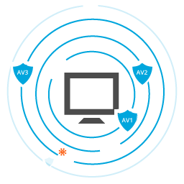

Prevention of security threats to the networks
Sebastian Cappadonna

Slide 2
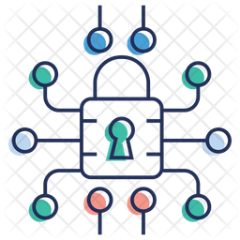
What is a Threat?
Threat to the network
anything that can take advantage of a vulnerability to breach security harm object or objects of interest.
Software attacks
Theft of intellectual property
Identity theft
Information extortion.

Slide 3
Common Security Threats to the Networks
Viruses and Worms
Adware and spyware
Drive-by Download Attacks
DDoS (Distributed Denial of Service)
Phishing Attacks
Ransomware
Cryptojacking
APT Threats (Advanced Persistent Threats)

Slide 4
How to Prevent Security threats to the Networks
Viruses and Worms
Destructive malicious programs designed to infect
How to prevent:
Installing anti-malware solutions
Keep software up to date
User Training

Slide 5

How to Prevent Security threats to the Networks
Adware and spyware
Any software that is designed to track data of your browsing
How to prevent:
Installing antivirus
Adblock browsing
User Training

Slide 6
How to Prevent Security threats to the Networks
Drive-by Download Attacks
Allows malicious code to be downloaded from an internet site through a browser without any action.
How to prevent:
Keeping your browser up-to-date
Use a safe search tool
User Training

Slide 7
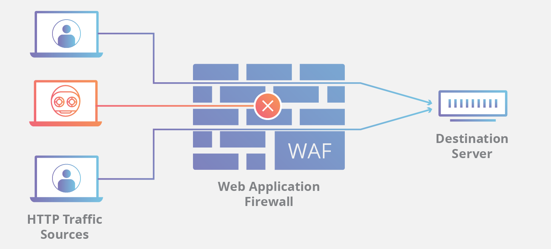
How to Prevent Security threats to the Networks
DDoS (Distributed Denial of Service)
Overwhelm the hosted servers of their targets with requests for data
How to prevent:
WAFs (Web Application Firewalls)
Quality of the SP
Notes:
overwhelm the hosted servers of their targets with requests for data,

Slide 8
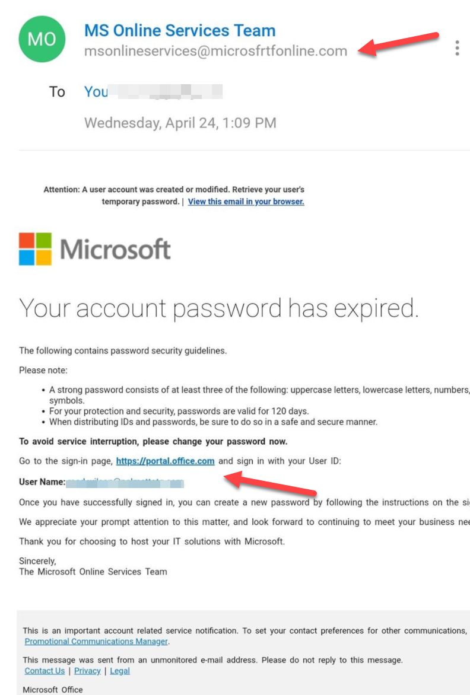
How to Prevent Security threats to the Networks
Phishing Attacks
Occurs when an attacker, acts as a trusted entity, dupes a victim into opening an email, instant message, or website.
How to prevent:
Vigilance is critical.
Look at the actual URL

Slide 9
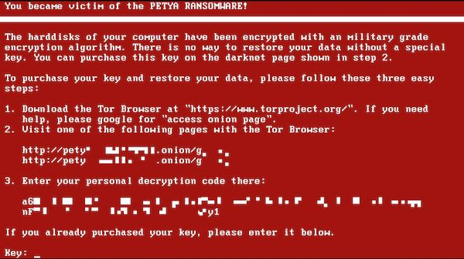
How to Prevent Security threats to the Networks
Ransomware
Infecting secure database systems, encrypting data, and threatening deletion or corruption of files.
How to prevent:
Antivirus software
Keeping software updated
Having a backup

Slide 10
How to Prevent Security threats to the Networks
Cryptojacking
Hackers can use their target’s CPU processing resources to mine for cryptocurrency,
How to prevent:
Diagnose CPU and GPU usage
Run Antivirus Analysis for Threats

Slide 11
How to Prevent Security threats to the Networks
APTs (Advanced Persistent Threats)
An unauthorized attacker access the network and stays for extended period of time, compromising all forms of data.
How to prevent
Install a Firewall
Email Protection
VPN
Implement Intrusion Prevention Systems

Slide 12
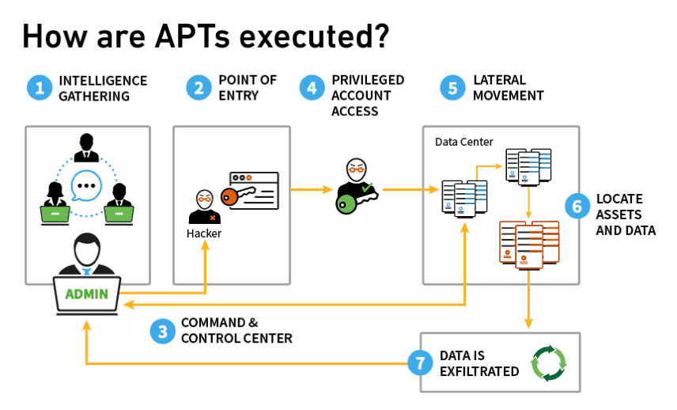

Slide 13
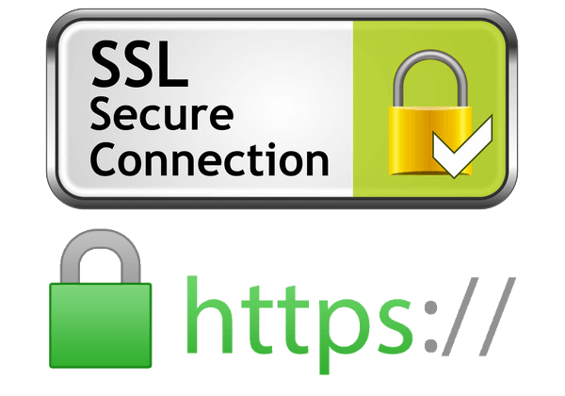
Don’t Forget!
Check the URLs
Use Antivirus
Don’t open unsecured websites
Don’t open emails from unknown users
Backup your data

Slide 14
Thank you!

